Slide 1
Support vector machine
Machine learning

Slide 2
Support vector machine:-
Support Vector Machine or SVM is one of the most popular Supervised Learning algorithms, which is used for Classification as well as Regression problems.
The SVM algorithm helps to find the best line or decision boundary, called hyperplane that classify the data points .

Slide 3
Support vector machine there are two types:-
1.Linear SVM(LSVM): Linear SVM is used for linearly separable data, which means if a dataset can be classified into two classes by using a single straight line, then such data is termed as linearly separable data, and classifier is used called as Linear SVM classifier.

Slide 4

Example of LSVM:-

Slide 5
Non-linear support vector machine:-
2.Non-linear SVM(NLSVM): Non-Linear SVM is used for non-linearly separated data, which means if a dataset cannot be classified by using a straight line, then such data is termed as non-linear data and classifier used is called as Non-linear SVM classifier.
NLSVM for non-linear data, we cannot draw a single straight line, here we use NLSVM Classifier.

Slide 6
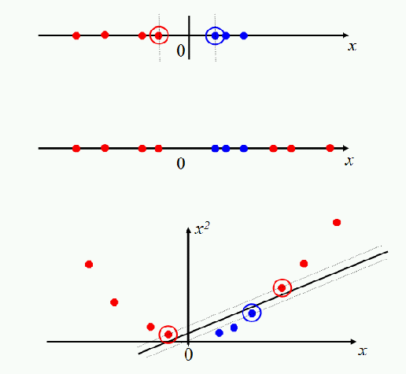
Example of Non-linear support vector machine:-

Slide 7
Support Vectors: The data points or vectors that are the closest to the hyperplane. SVM algorithm finds the closest point of the lines from both the classes. These points are called support vectors.
Margin: The distance between the support vectors is called as margin and the goal of SVM is to maximize this margin.

Slide 8
Hyperplane: The SVM algorithm helps to find the best line or decision boundary, this best boundary or region is called as a hyperplane. We always create a hyperplane that has a maximum margin, which means the maximum distance between the data points. The hyperplane with maximum margin is called the optimal hyperplane.

Slide 9
Kernel Trick / Kernel function:
A kernel transforms a low-dimensional input data space into a higher dimensional space. So, it converts non-linear separable problems to linear separable problems by adding more dimensions to it. Thus, the kernel trick helps us to build a more accurate classifier.
Hence, it is useful in non-linear separation problems.

Slide 10
Four popular kernels available in SVM:-
This are….
1. Linear kernel,
2. Polynomial kernel,
3.Radial Basis Function (RBF) kernel.
4.Sigmoid kernel.

